Slide 1
Getting Everyone Together:
Improving Outcomes with Better Data

Slide 2
OSEP Disclaimer
2019 OSEP Leadership Conference
DISCLAIMER:
The contents of this presentation were developed by the presenters for the 2019 OSEP Leadership Conference. However, these contents do not necessarily represent the policy of the Department of Education, and you should not assume endorsement by the Federal Government.
(Authority: 20 U.S.C. 1221e-3 and 3474)

Slide 3
Presenters
Joanna La Guardia California Department of Education Special Education Division jlaguardia@cde.ca.gov | Jacqueline Williams Assistant Superintendent West San Gabriel Valley SELPA williams_jacqueline@ausd.us
Heather Reynolds IDEA Data Center Westat HeatherReynolds@westat.com | Dr. Jon Eyler Collaborative Learning Solutions, LLC jeyler@clsteam.net

Slide 4
Journey
California’s System of Support
Context and call for need
Data Bootcamps
Local Educational Agency (LEA) Pilot
Current development and tools

Slide 5
California’s System of Support Goal
To assist LEAs and their schools to meet the needs of each student served, with a focus on building capacity to sustain improvement and effectively address inequities in student opportunities and outcomes.

Slide 6
IDEA: Special Education Indicators
1. Graduation 2. Drop Out 3. Assessment 4. Suspension/Expulsion 5. Least Restrictive Environment (LRE) 6. Preschool LRE 7. Preschool Assessment | 8. Parent Input 9. Disproportionality 10. Disproportionality by Disability 11. 60 Day Timeline 12. C to B 13. Transition 14. Post School Outcomes

Slide 7
California’s Eight State Priorities for School Districts and Charter LEAs
1. Basic Services
2. Implementation of State Standards
3. Parental Involvement
4. Pupil Achievement
5. Pupil Engagement
6. School Climate
7. Course Access
8. Other Pupil Outcomes

Slide 8
What is the California School Dashboard?
The Dashboard is a powerful online tool to help districts and schools identify strengths and weaknesses and pinpoint student groups that may be struggling
It reports performance and progress on both state and local measures
Is designed to support the local strategic planning process

Slide 9
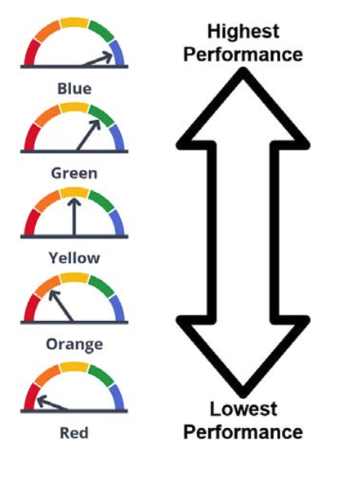
Performance Levels

Slide 10
Performance Levels (cont.)
At least two years of data are needed to determine the performance level (of color) for a state indicator:
Current Year Data: To calculate Status
Prior Year Data: To calculate Change

Slide 11
Call for Need and Collaboration with CIID
70% of LEAs identified for Differentiated Assistance in the California Dashboard are due to outcomes for their students with disabilities
The California Department of Education (CDE) recognized the need to improve understanding and capacity for high quality data
In anticipation of technical assistance, CDE collaborated with the Center for the Integration of IDEA (CIID) to develop an LEA Self-Assessment for Data

Slide 12
Data Bootcamps
Six Data Bootcamps held throughout the state May and June 2018
One-day training for LEA representatives to focus on understanding the impact of data source and quality of data for students with disabilities
65 LEAs were invited to participate and a total of 258 participants attended
Participants rated the training 4.6 out of 5
"The structure worked very well! Specific topic, guidance, team conversation. I also loved that we had real data to look at."

Slide 13
Root Causes
LEAs worked with their teams, which included, but was not limited to: the Director of Special Education, Director of Technology, Superintendent of Student Services, Student Information Systems Coordinator, and SELPA Administrators
Data Teams:
Worked through the LEA Self-Assessment;
Reviewed their own data; and,
Developed an improvement plan

Slide 14
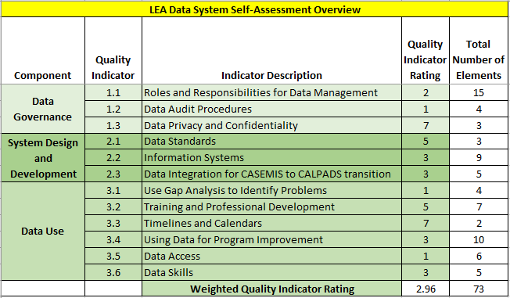
Self-Assessment

Slide 15
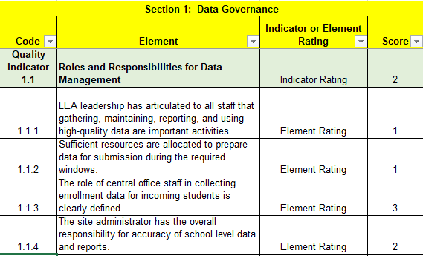
Self-Assessment (cont.)

Slide 16
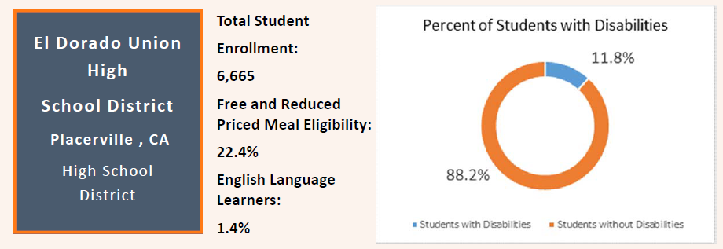
Data Display Excerpt

Slide 17
Data Display Excerpt (cont.)

Slide 18
Then what?
CDE recognized the need for support for selected LEAs
Piloted a facilitated self-assessment process; added documentation and priority-setting activities to strengthen improvement planning
Designed additional structured activities to support districts in their identified improvement activities
Broadened the working group to expand usability testing, gain practitioner perspective, refine Data Toolkit, and prepare for scale-up of implementation

Slide 19
Development of Data Toolkit
Step 1: Data Governance team
Step 3: District Landscape(s)
Step 4: Priority Setting Activity
Step 5: Data Improvement Plan
Step 6: Policies and Procedures for Data Systems
Step 2: Self Assessment

Slide 20
CDE’s Investment in Data Quality to Improve Outcomes for Students with Disabilities
California committed $10 million over 5 years to improve the quality of Special Education data
Special Education Local Plan Areas (SELPA) were awarded grants to improve capacity

Slide 21
Collaborative

Slide 22
Next Steps
Transition LEA Self-Assessment to online format
Professional Development for Data Toolkit
Continued development of Improvement Activities Data Tools

