Slide 1

Addressing Significant Disproportionality: How One State and One LEA Are Using IDC Success Gaps Tools to Make Meaningful Change
November 4, 2015
Presented by:
Nancy O’Hara, IDC
Jody Fields, Arkansas
Jean Coles and additional staff, Blytheville Schools, Arkansas

Slide 2
Today’s Agenda
Information about the Success Gaps tools: Nancy O’Hara
The Arkansas process for significant disproportionality: Jody Fields
The story of Blytheville School District, Arkansas: Jean Coles and other Blytheville staff

Slide 3


Equity, Inclusion and Opportunity: Addressing Success Gaps
https://ideadata.org/resource-library/54611b49140ba0d8358b4569/
Notes:
Intendend audiences:
State departments of education
Local school districts
Schools
TA providers, professional developers, & consultants working with districts and schools
Other stakeholders concerned about equity issues in schools
General Ed. and Special Ed.

Slide 4
What is a success gap?
Differences or “gaps” in a variety of educational factors and outcomes that affect the likelihood of educational success for some groups of students compared to their peers
  Achievement
  Identification and/or placement for special education
  Suspension rates
  College and career preparation
  Graduation rates
Notes:
Ask participants what they think a success gap is? before clicking to show the answer..

Slide 5
Why Equity, Inclusion and Opportunity:
Addressing Success Gaps?
All states/districts/schools have subgroups of students who do not achieve as well as others
Success Gaps tools present a process for identifying where the gaps are and why they are occurring.
Then a plan may be created to address the root causes of the success gaps.

Slide 6

Structure of the Document(s)
White paper: Introductory research brief
Self-assessment rubric with 5 focus areas
  Data-Based Decision Making
  Cultural Responsiveness
  Core Instructional Program
  Assessment
  Evidence-Based Interventions
  and Supports

Slide 7

Data-Based
Decision Making
Use disaggregated data for decisions about
  Curriculum and instructional programs
  Academic and behavioral supports
  Are policies and procedures effective?
Make decisions about student interventions using multiple data sources, including
  Screening
  Progress monitoring
  Formative and summative evaluation data

Slide 8

Cultural Responsiveness
Recognize diversity across student ethnicity, language, and socio-economic status
Provide training and resources so teachers can meet the linguistic needs of all students
Include parents from all backgrounds in discussions about the school and about their children’s progress
Notes:
Note about parents included in each section!

Slide 9

Core Instructional Program
Rigorous, consistent, and well-
articulated K-12 instructional
program, aligned with standards,
delivered with fidelity
Effective differentiation in the core curriculum
Universal design for learning
Informing parents in their native or home language about differentiation

Slide 10

Assessment
Valid universal screening
Progress monitoring for all
students
Informing parents in their
native or home language
about results

Slide 11
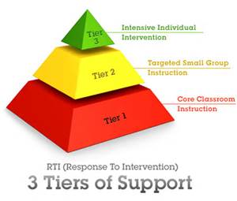
Evidence-Based
Interventions and Supports
Implemented with fidelity
Instructional
Behavioral
  Such as Positive Behavioral Supports or Restorative Justice
  Tiered response protocols, not zero tolerance
Informing parents in their native or home language about interventions and responses
Notes:
What are we missing? Are there other areas you would include?
What do you think? In your school or district, there is room for improvement in:
Data based decision making
Cultural responsiveness
Core instructional program
Assessment
Evidence based interventions and support

Slide 12
To address success gaps…
… look closely at equity, inclusion, and opportunity for children in the affected groups
Notes:
Polling question (select all that apply)
In your school or district setting who are the affected subgroups?
Low SES
Students with disabilities
English Language Learners
Student who are white
Students who are black
Students who are Hispanic
Other

Slide 13
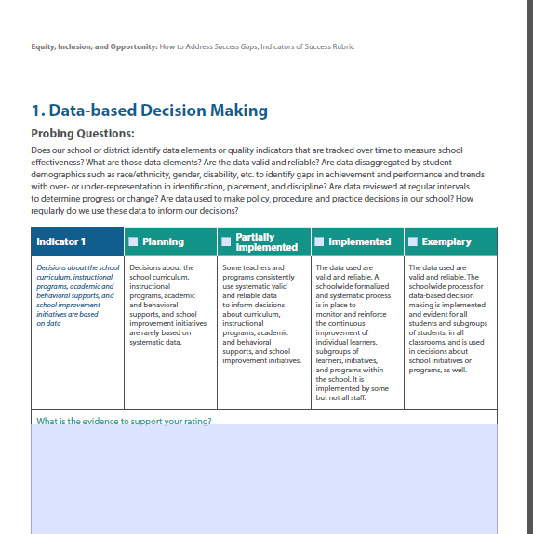
Rubric Organization
Rubric rating scale
Content Area
Probing Questions
Indicator
Text box to describe evidence to support rating of the team
Notes:
Lets start with the set up of the rubric. Each section or content area is set this way. Many of the content areas have more than one indicator and therefore are on multiple pages.
The scale is is the same across each area, Planning, Partially Implemented, Implemented, Exemplary, although described below the scale in the description of the indicator.

Slide 14
How to Address Success Gaps
Form a team
Study the data
Conduct a self-assessment
Provide evidence
Consider the students first
Ensure equitable participation
Develop a plan of action

Slide 15


What are the results of success gaps?
Poor long-term outcomes for entire groups of students
Notes:
Before clicking on the answer to make it appear, ask the participants to share thoughts….pick only a couple of participants

Slide 16

Arkansas’ Process for Significant Disproportionality
Jody Fields, PhD
Director, IDEA Data & Research
Special Education Data Manager

Slide 17
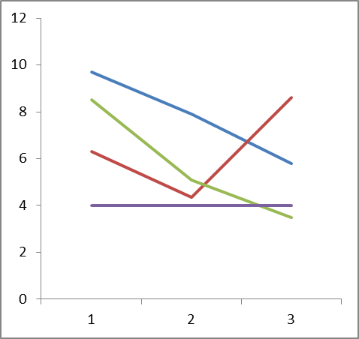
Where it begins?
Identification of districts is made using
  risk ratios;
  significant differences; and
  requires a three year pattern.
If a district meets the threshold in year four they are removed from significant disproportionality.
The three year pattern will start over if the district is identified in a single year.

Slide 18
Notification Process
Letters are sent to districts
  Area of disproportionality including the data
  A link to their Disproportionality/CEIS District Profile
  Required documents for submission by deadline
    Self-assessment (link to document online)
    CEIS Plan

Slide 19
2014/15
3 districts identified
  Black ID
  White OHI
  Black Discipline
Special One-Day Workshop: Success Gap Rubric
  All three districts brought teams
  Started the rubric at workshop and then completed it back in district
  Had to submit Rubric to SEA for review.
  Had the option to modify CEIS plan and resubmit

Slide 20
2015/16
2 districts identified
  Black Discipline
  Black SLD
The Rubric as introduced to all districts during the Data Summit in June 2015.
Rubric is posted online for all districts to use…optional

Slide 21
Upcoming Changes
Spring 2016 Disproportionality Workshop
  Districts identified for review of policies, procedures, and practices
    Ins and Outs of disproportionality (APR vs CEIS)
    Success Gap Rubric
    And more….
2016/17: Visits to districts prior to reaching three years
  Onsite visits to districts with a 2 or more years of identification.
    Includes all disproportionality areas including 4A of APR

Slide 22
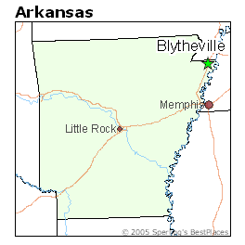
Blytheville School District
I am pleased to present Ms. Jean Cole, Special Education Supervisor at the Blytheville School District. Ms. Cole is here to share with us Blytheville’s story.
Ms. Cole has embraced the use of the Success Gap Rubric across her district. Utilizing it not only a the district level, but at the building level as well.

Slide 23
Not So Easy
“Equity, inclusion and opportunity for all students is an important goal, but one that is not easily achieved.”
(EIO)

Slide 24

Questions/Discussion
What questions do you have for the presenters?
What thoughts do you have about using any of the Success Gaps materials?

Slide 25
Support is available
The IDC Disproportionality and Equity Workgroup can support a state’s desire to implement activities with Success Gaps.
Materials are on the IDC website in the resource library: www.ideadata.org; search for “success gaps”.
Toolbox is coming.

Slide 26
Contact your IDC state liaison or the IDC equity team:
Julie Bollmer, co-lead, juliebollmer@westat.com
Tom Munk, co-lead, tommunk@westate.com
Nancy O’Hara, nancy.ohara@uky.edu
Cesar D’Agord, cdagord@wested.org
Kristin Reedy, kreedy@wested.org
Terry Long, terry.long@sped-data.com

Slide 27

For More Information
Visit the IDC website
http://ideadata.org/
Follow us on Twitter
https://twitter.com/ideadatacenter

Slide 28




The contents of this presentation were developed under a grant
from the U.S. Department of Education, #H373Y130002. However,
the contents do not necessarily represent the policy of the Department
of Education, and you should not assume endorsement by the
Federal Government.
Project Officers: Richelle Davis and Meredith Miceli
Project Officers: Richelle Davis and Meredith Miceli

